Slide 1

e-Desk

Slide 2
Problems
Complexities of Complaints, Suggestions and Applications
Lack of Transparency and Accountability
Uncertainty in keeping records

Slide 3
At a Glance
8
38
22
20-30
Faculties
and Institutes
Clubs
and Societies
Departments
Offices
Source: www.jnu.ac.bd

Slide 4
Solution
Students will be able to use the system to send their requests, suggestions, and complaints to the appropriate authority.
Based on the submission information, the authority can take the appropriate action and will immediately inform the student.
The entire process can be readily monitored by higher authorities, and decisions can be made quickly.

Slide 5
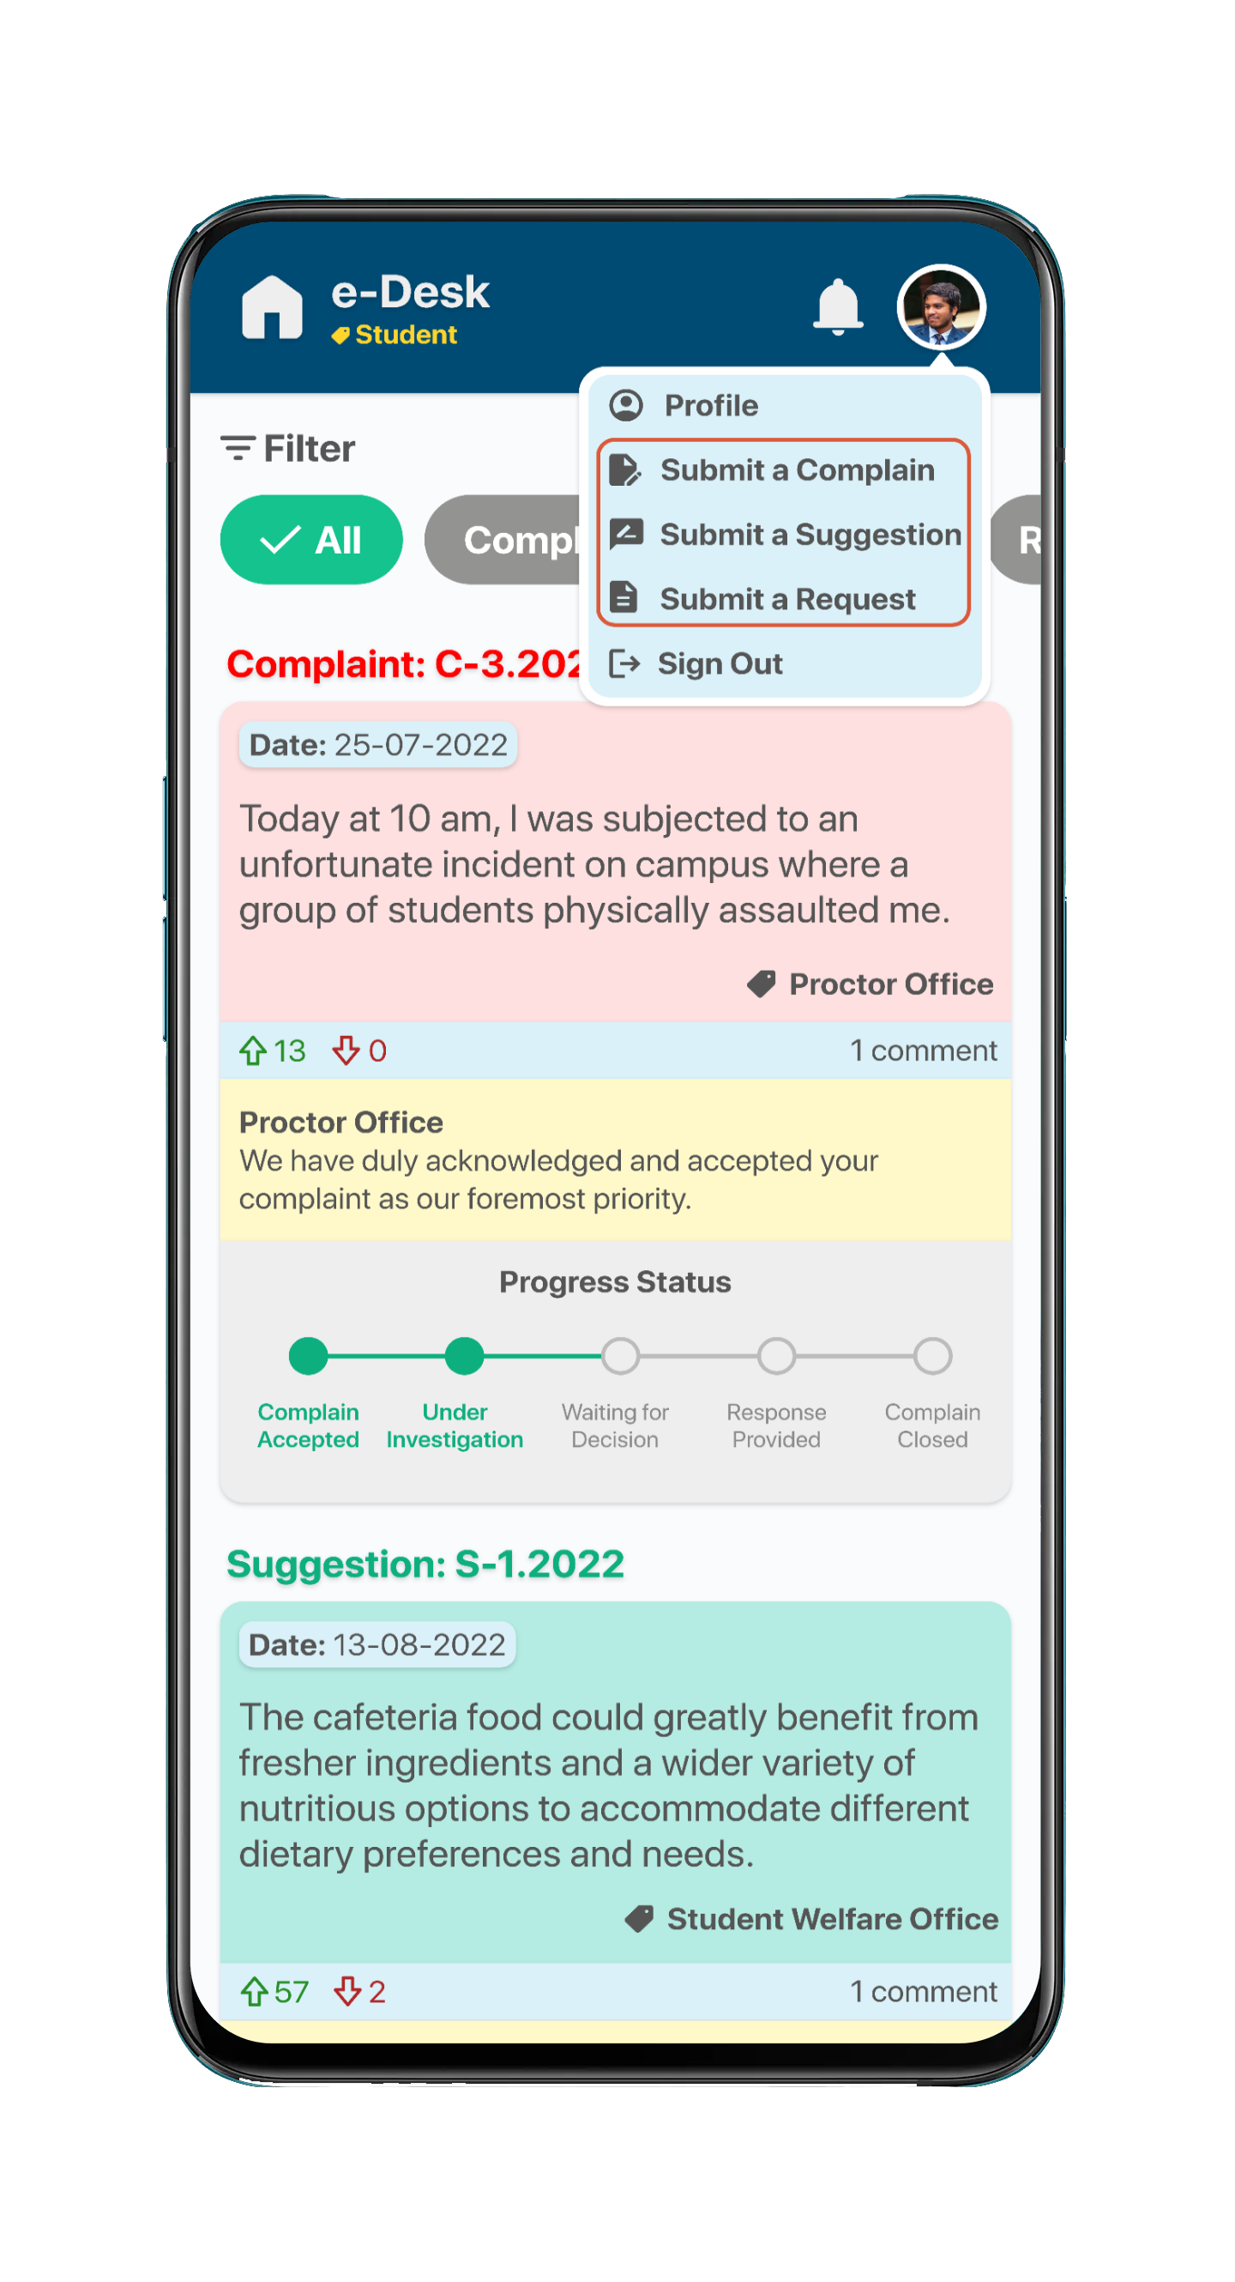
Office-specific submissions
Students can directly submit their complaints, suggestions, or requests to a specific office or department, ensuring targeted communication.
Efficient tracking
Students can easily monitor the status and progress of their submissions related to a particular office.
Digital Record
Since the information will be saved digitally, it is less likely to be lost or forgotten.

Slide 6
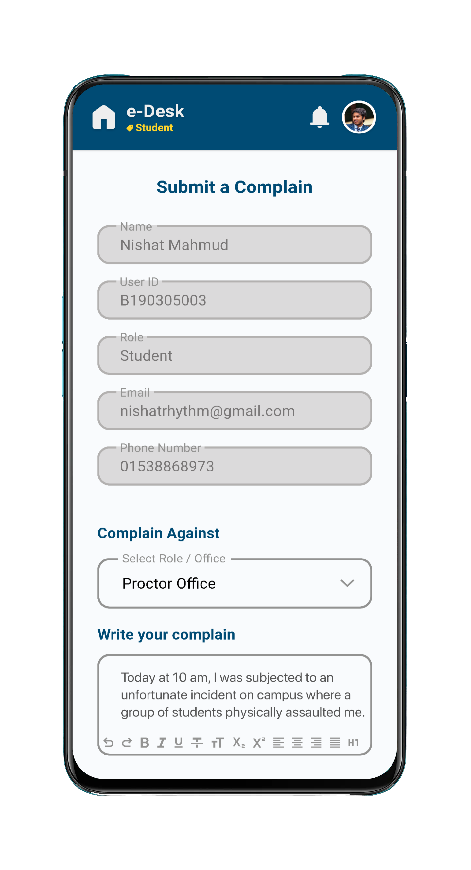
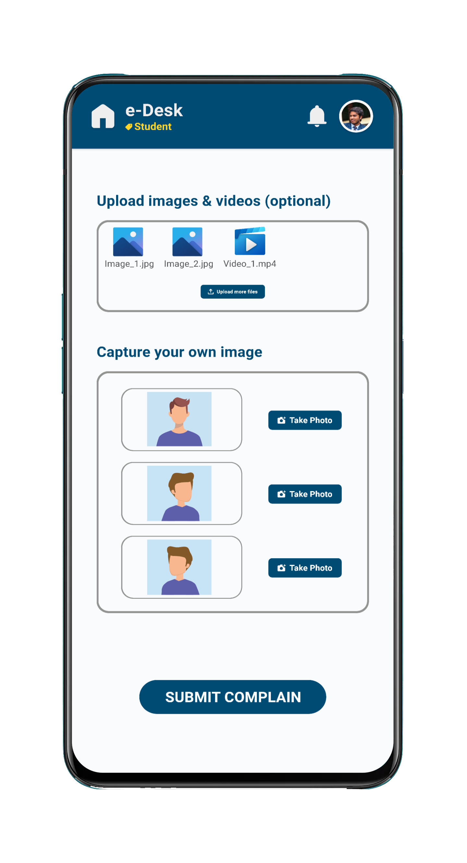
Automatically retrieve student information.
Select the desired office for filing a complaint.
Describe the complaint.
Upload relevant media.
Take a personal image for verification purposes.

Slide 7
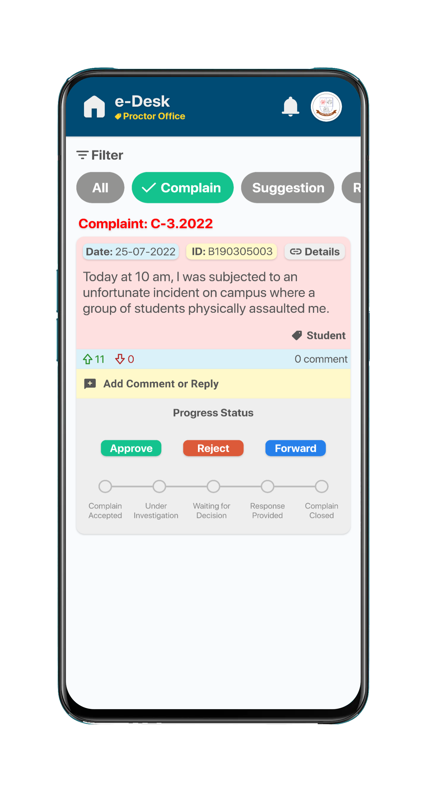
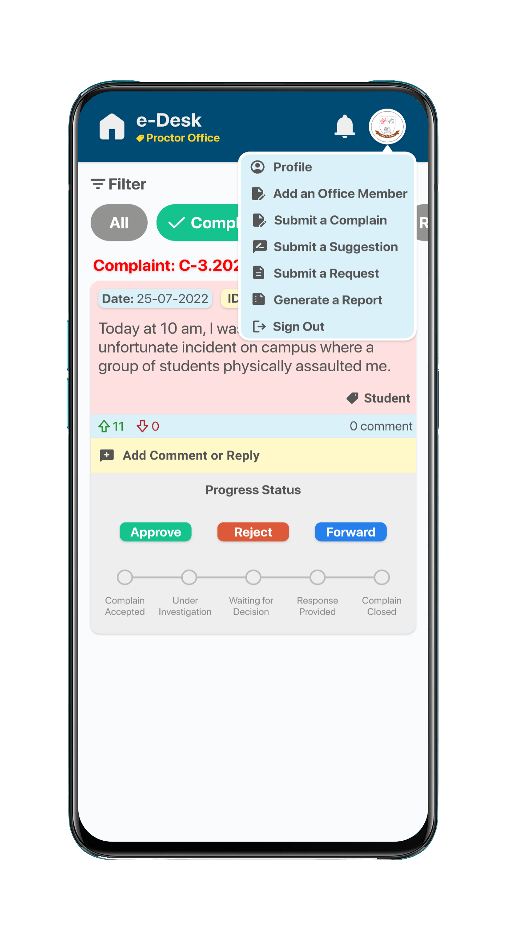
The admin can see the user posts on their home page.
Admin can approve or reject valid or invalid complaints and forward them to the respective office if needed.
Admin can comment or reply to posts.
Progress status shows the current complaint status.

Slide 8
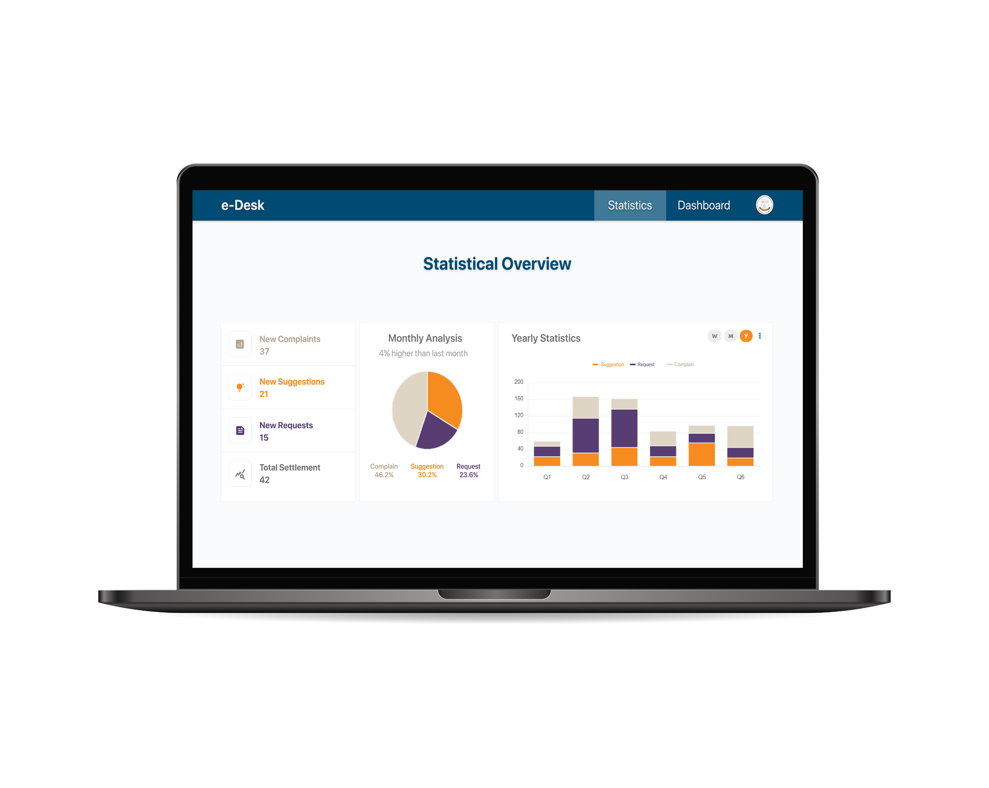

Slide 9
System Development
We are expecting to finish this project within the next four months.

Slide 10
